Slide 1

IBM NALAIYA THIRAN
TEAM ID:PNT2022TMID44299
PROJECT DOMAIN: CLOUD APLLICATION DEVELOPMENT
PROJECT TITLE: SMART FASHION RECOMMENDER SYSTEM
PRESENTED BY:
Mohanappuviya S
Dhivyabharathi M
Akshayaa M
Oviya N

Slide 2

Problem Statement
Proposed Solution
Technical Architecture
Working Demo
Performance Metrics
Future Scope

Slide 3
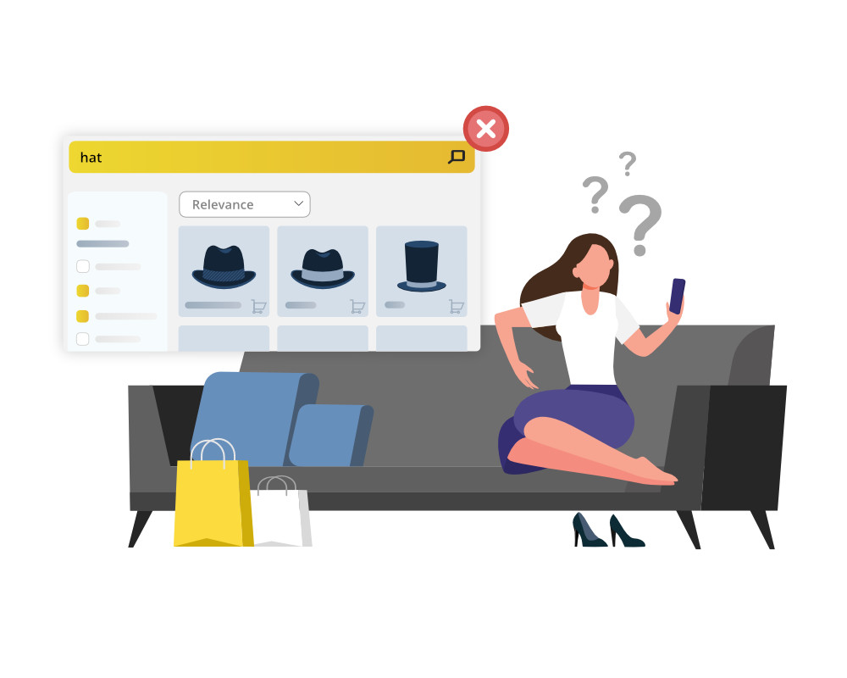
PROBLEM STATEMENT
In shopping apps navigating to the desired product is very difficult and no proper assistance will be provided.
Many online shoppers expect a system that used to recommend products based on their choices.
Make users buy more products and to provide a friendly system.
The smart fashion recommender application leverage the use of a chatbot to interact with user, gather information about their preference, and recommend suitable products to users.
The main objective of this application is to provide better interactivity with user and to reduce navigating pages to find appropriate products.

Slide 4

PROPOSED SOLUTION:
Proper assistance will be provided which offers rich set of interaction that help improve preference and interact with users through natural language.
Customers can purchase the products without any search. The chatbot recommend their present based on their histories.
The proposed model can recommend products that are more suitable to the customers.
Due to market dynamics and customer preference, there is a large vocabulary of distinct fashion product as well as high turnover of traditional recommender system for better experience and feasibility.
Scalability of solution- application can be made scalable by increasing the number of product and varieties with increasing customer.

Slide 5
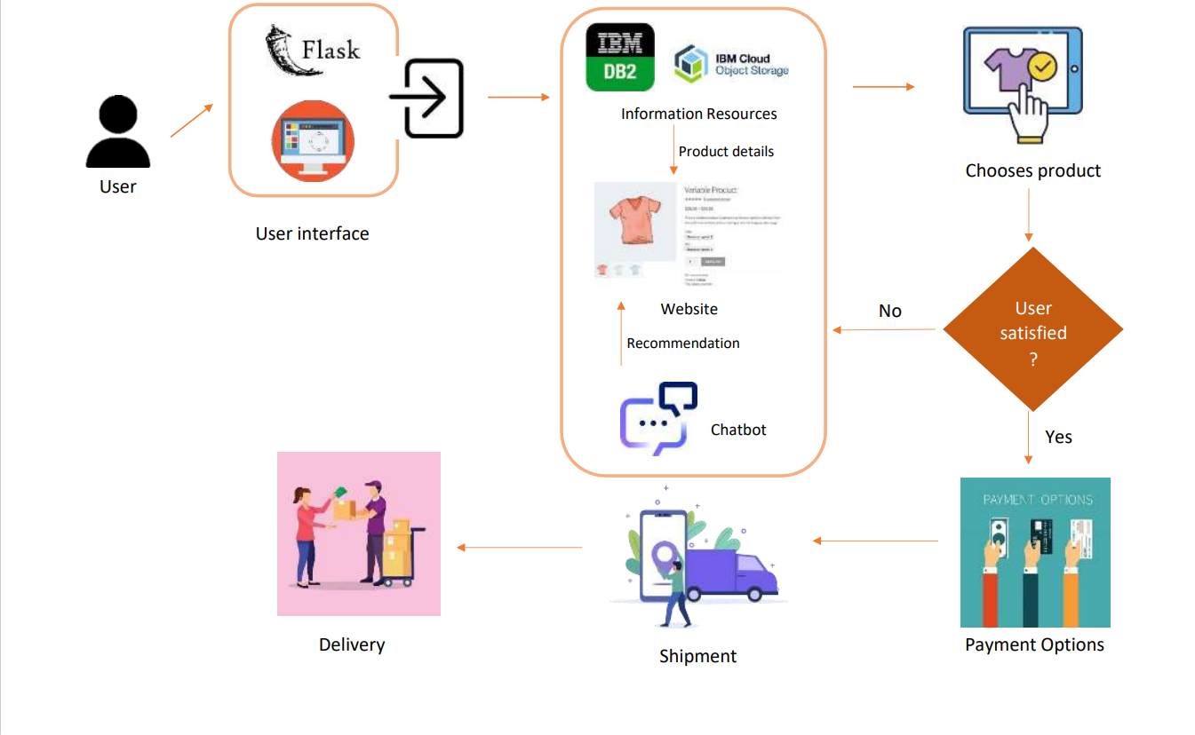
TECHNICAL ARCHITECTURE:

Slide 6

FUTURE SCOPE:
The scope of this system can be expanded by including the ability to detect the various design patterns on clothing based on different criteria.
Sustainability and digitization are the two major categories that will determine and change the fashion trends in future. No brand or Retailer will be able to avoid them.

Slide 7

THANK YOU!

